Slide 1

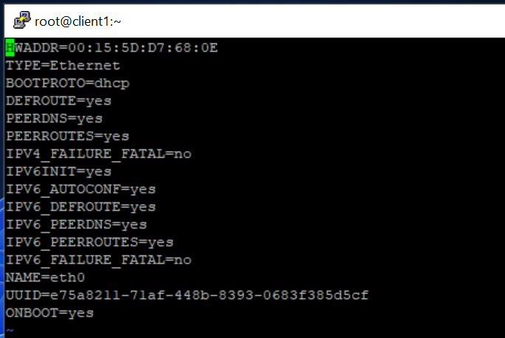
Capstone Project
Requirement-1
a)

Slide 2
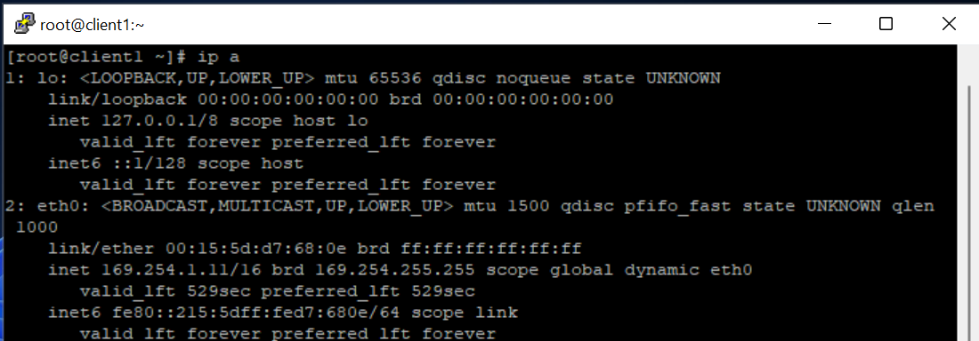

Slide 3


b)

Slide 4


Slide 5
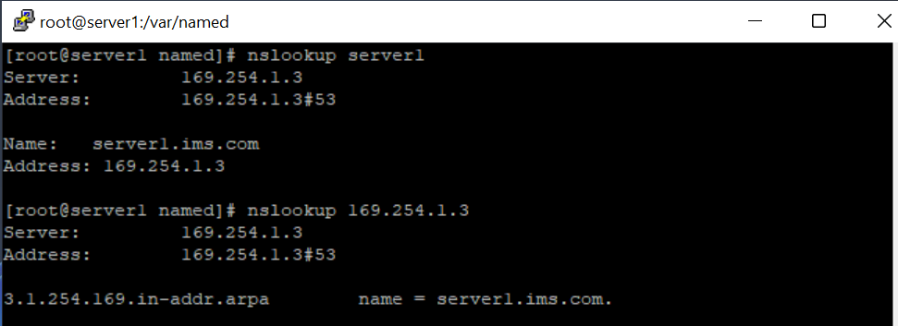
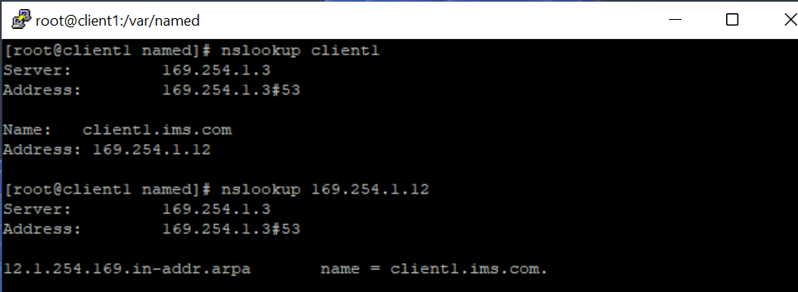
Requirement-2

Slide 6


Slide 7
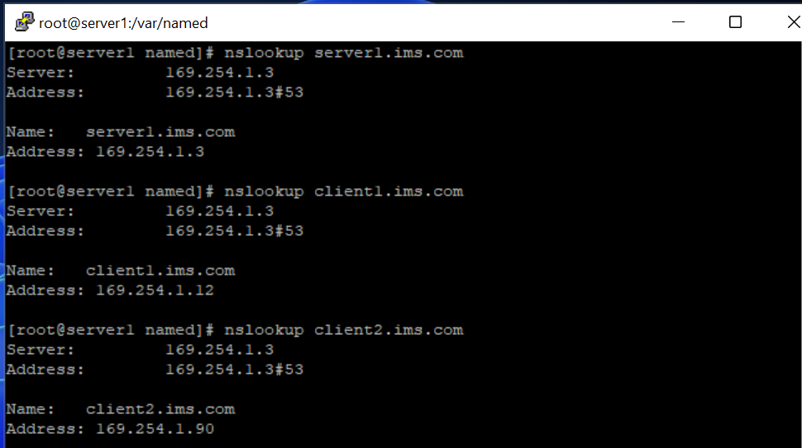
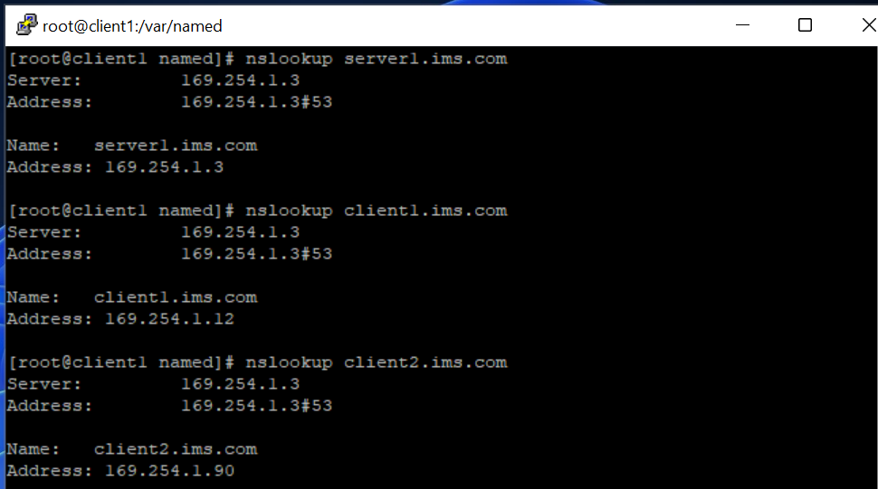

Slide 8
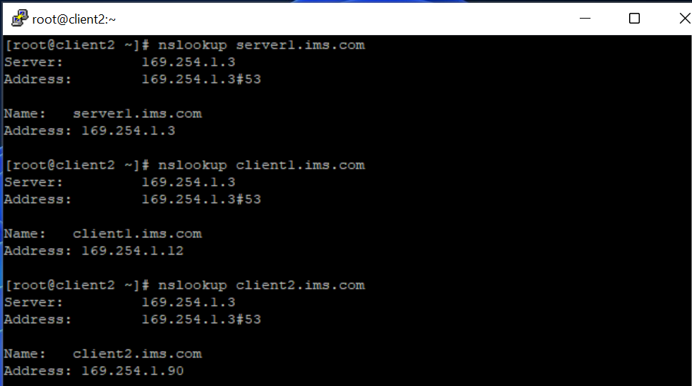

Slide 9

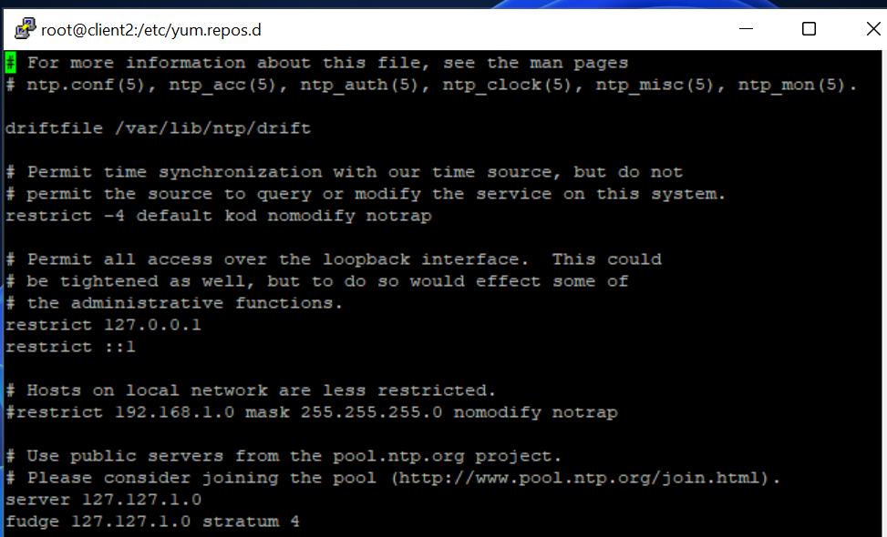
Requriement-5

Slide 10
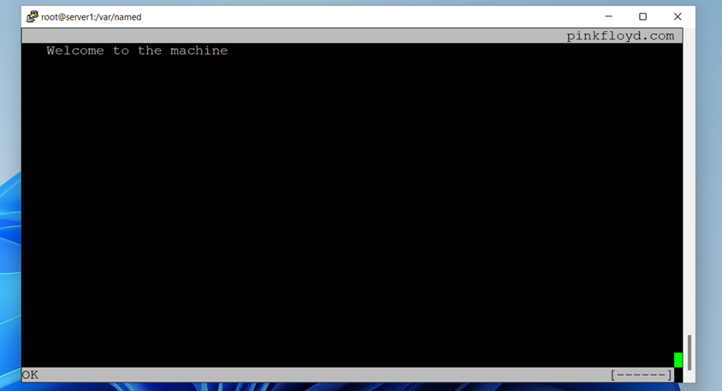
Requirement-3

Slide 11


Slide 12


Slide 13


Slide 14


Slide 15


Slide 16
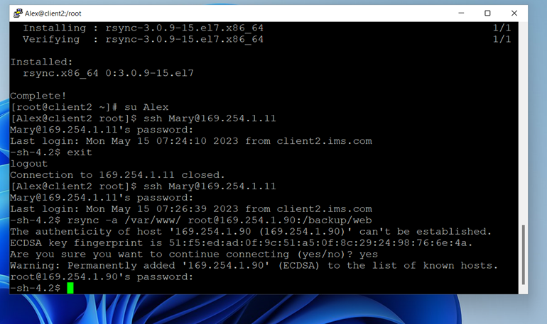
Requriment-4

Slide 17


